Slide 1
Fiber Optics
Notes:
MPASC Collge Panvel

Slide 2
Introduction
An optical fiber is essentially a waveguide for light
It consists of a core and cladding that surrounds the core
The index of refraction of the cladding is less than that of the core, causing rays of light leaving the core to be refracted back into the core
A light-emitting diode (LED) or laser diode (LD) can be used for the source
Advantages of optical fiber include:
  Greater bandwidth than copper
  Lower loss
  Immunity to crosstalk
  No electrical hazard

Slide 3
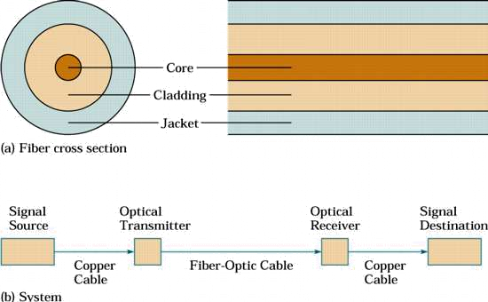
Optical Fiber & Communications System

Slide 4
Optical Fiber
Optical fiber is made from thin strands of either glass or plastic
It has little mechanical strength, so it must be enclosed in a protective jacket
Often, two or more fibers are enclosed in the same cable for increased bandwidth and redundancy in case one of the fibers breaks
It is also easier to build a full-duplex system using two fibers, one for transmission in each direction

Slide 5

Total Internal Reflection
Optical fibers work on the principle of total internal reflection
With light, the refractive index is listed
The angle of refraction at the interface between two media is governed by Snell’s law:

Slide 6
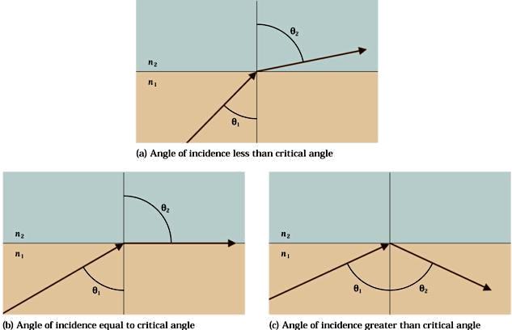
Refraction & Total Internal Reflection

Slide 7
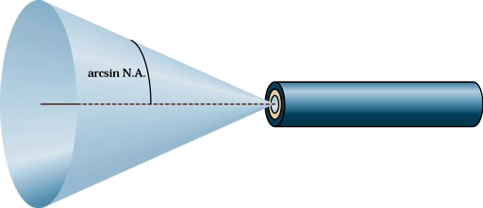
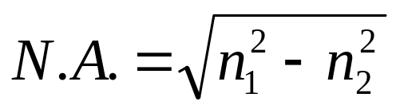
Numerical Aperture
The numerical aperture of the fiber is closely related to the critical angle and is often used in the specification for optical fiber and the components that work with it
The numerical aperture is given by the formula:
The angle of acceptance is twice that given by the numerical aperture

Slide 8
Modes and Materials
Since optical fiber is a waveguide, light can propagate in a number of modes
If a fiber is of large diameter, light entering at different angles will excite different modes while narrow fiber may only excite one mode
Multimode propagation will cause dispersion, which results in the spreading of pulses and limits the usable bandwidth
Single-mode fiber has much less dispersion but is more expensive to produce. Its small size, together with the fact that its numerical aperture is smaller than that of multimode fiber, makes it more difficult to couple to light sources

Slide 9
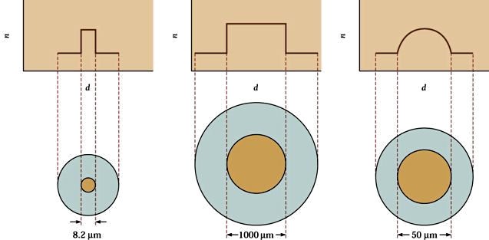
Types of Fiber
Both types of fiber described earlier are known as step-index fibers because the index of refraction changes radically between the core and the cladding
Graded-index fiber is a compromise multimode fiber, but the index of refraction gradually decreases away from the center of the core
Graded-index fiber has less dispersion than a multimode step-index fiber

Slide 10
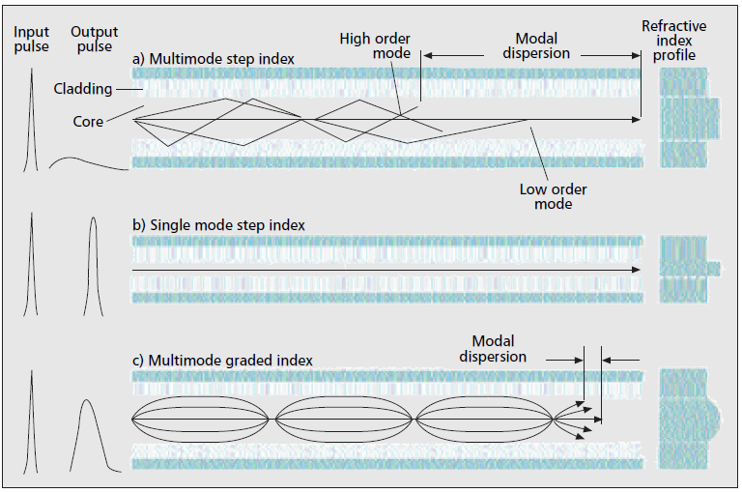
Fibre types – how do they differ?
Source: P.Polishuk, “Plastic Optical Fibers Branch Out”, IEEE Commn. Mag., Sep.2006, pp. 140-148.

Slide 11
Dispersion
Dispersion in fiber optics results from the fact that in multimode propagation, the signal travels faster in some modes than it would in others
Single-mode fibers are relatively free from dispersion except for intramodal dispersion
Graded-index fibers reduce dispersion by taking advantage of higher-order modes
One form of intramodal dispersion is called material dispersion because it depends upon the material of the core
Another form of dispersion is called waveguide dispersion
Dispersion increases with the bandwidth of the light source

Slide 12
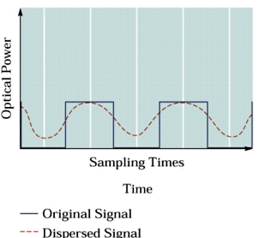
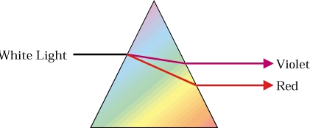
Examples of Dispersion

Slide 13
Losses
Losses in optical fiber result from attenuation in the material itself and from scattering, which causes some light to strike the cladding at less than the critical angle
Bending the optical fiber too sharply can also cause losses by causing some of the light to meet the cladding at less than the critical angle
Losses vary greatly depending upon the type of fiber
  Plastic fiber may have losses of several hundred dB per kilometer
  Graded-index multimode glass fiber has a loss of about 2–4 dB
  per kilometer
  Single-mode fiber has a loss of 0.4 dB/km or less

Slide 14
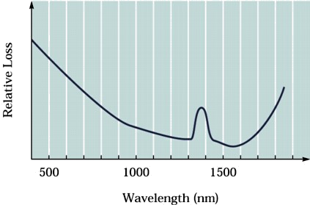
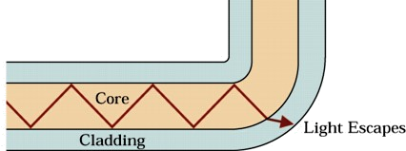
Types of Losses

Slide 15
Fiber-Optic Cables
There are two basic types of fiber-optic cable
  The difference is whether the fiber is free to move inside a tube with a diameter much larger than the fiber or is inside a relatively tight-fitting jacket
They are referred to as loose-tube and tight-buffer cables
Both methods of construction have advantages
  Loose-tube cables—all the stress of cable pulling is taken up by the cable’s strength members and the fiber is free to expand and contract with temperature
  Tight-buffer cables are cheaper and generally easier to use

Slide 16
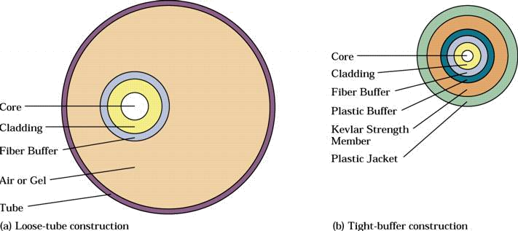
Fiber-Optic Cable Construction

Slide 17


